Slide 1
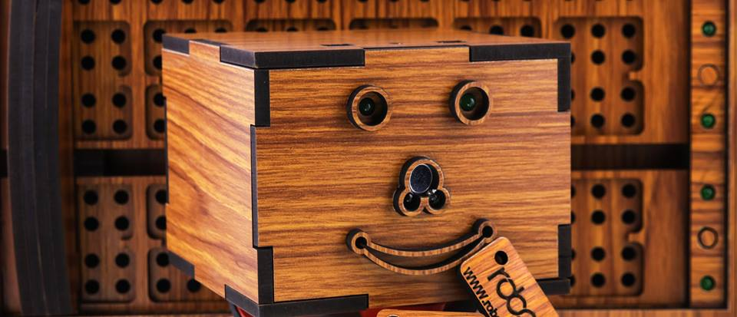
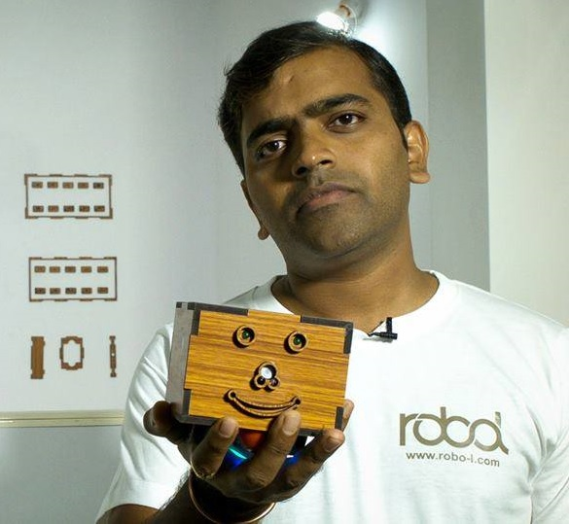
Meet Robol-Nex :
World’s First Physically Programmable Robot
Physical Programming with Rora
Everyone is wondering when we would be able to speak with a Robot? When would it be that I will command my Robot to bring a cup of tea or wake me up exactly at sunrise in the morning?
Physical programming interface is the simplest language to communicate with a Robot. The functions are written on physical blocks and commands the Robot to act according to the sentences formed using these functions.
You can’t talk to the Robot but you surely can write it down for him in simple plain English. Yes that’s true it’s not a distant future now, The future is Now.

Slide 2

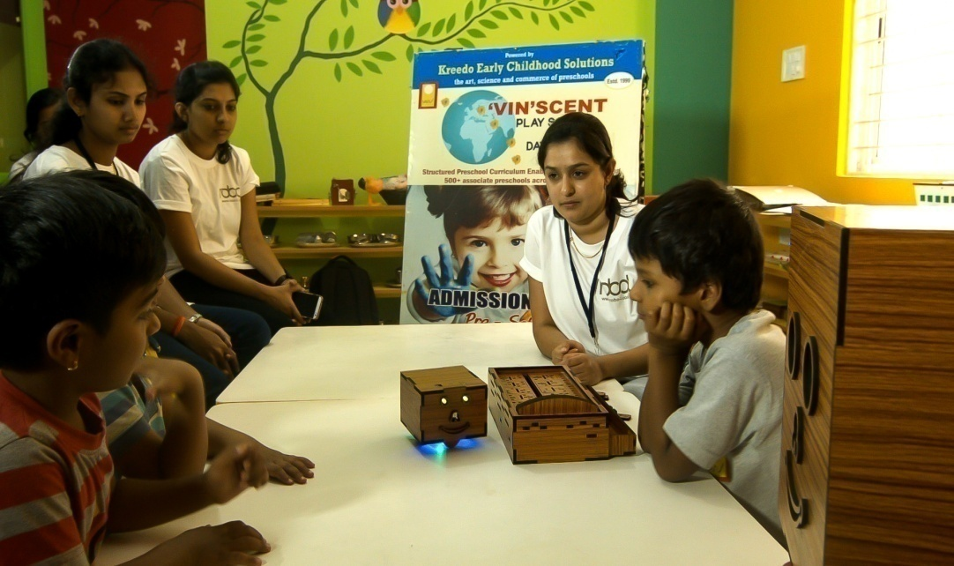
Inspire Logical Thinking and Problem Solving Skills with Fun and Games
Programmers are well known for their critical Problem solving Skills. But how will a Kid like you, me, Jhon, Kumar and Rora will learn the one of the most complex Technical platform in the world?
Here physical programming comes to aid. With innovative games you will understand the concepts of Programming Logics. The Playcards will help you learn the concepts in most joyful ways. Solve and execute different tasks using your creativity. Programming was never this fun.

Slide 3
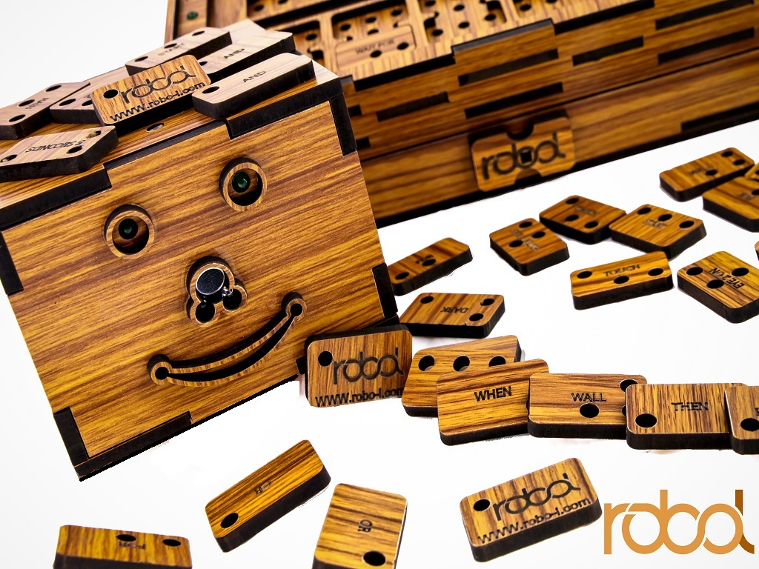
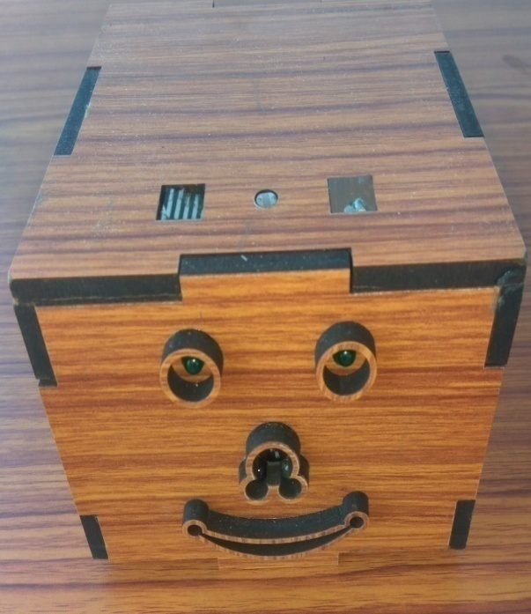
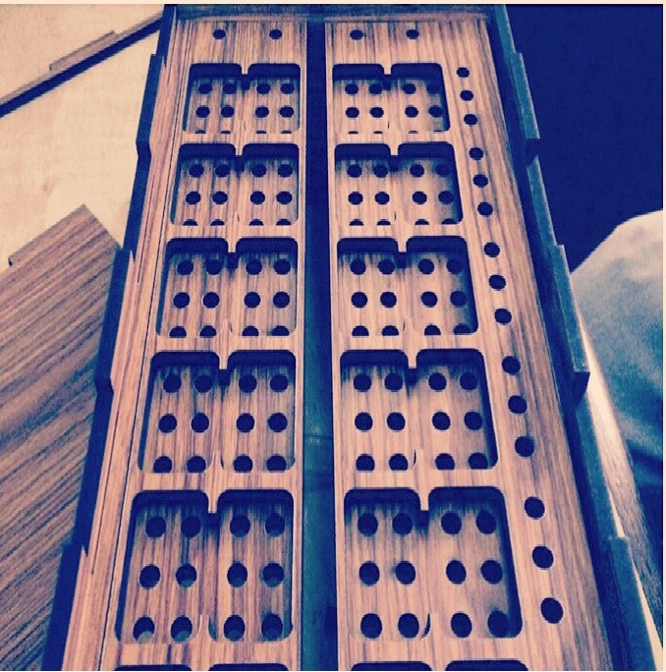
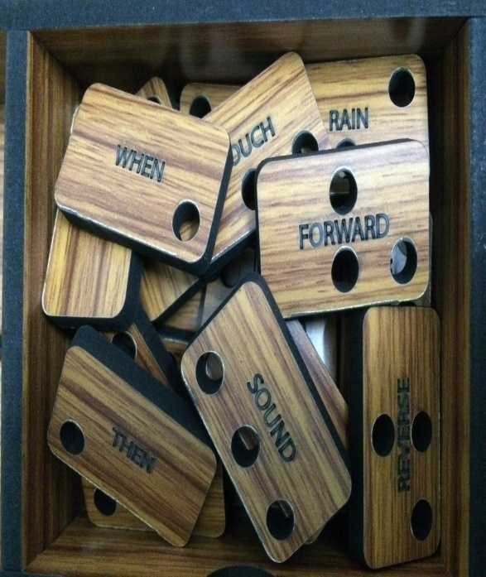
MEET THE ALLIANCE
Robol-Nex has three buddies to help you Play.
Rora, the Bot.
Slate, the interface.
Coins, the commands.
Rora
The Slate
Coins

Slide 4
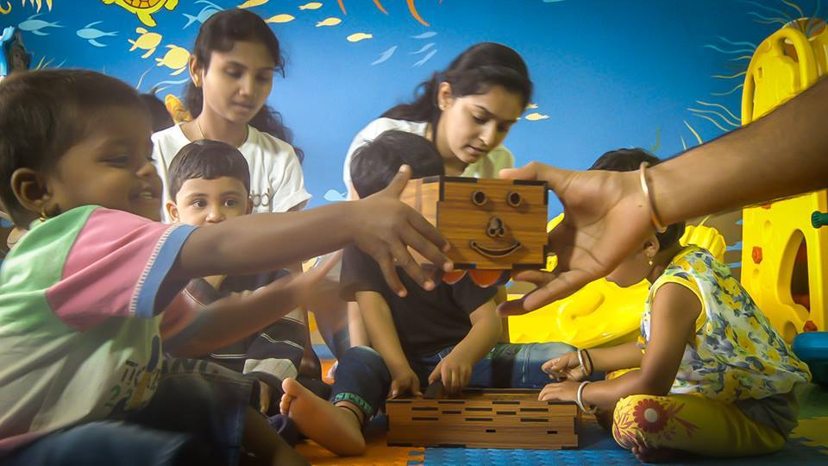
Rora
Rora is confined with two Motors that receive Info via RF Transmitters. She is equipped with LEDs, LDRs and rain sensors to provide a responsive and active environment. The transmitter receives signals from the Slate which is physically programmed by Inserting Specified coins into the Slots. Rora can be Programmed for various functions and tasks.
She has 5 primary sensors Light, Sound, Touch, Rain and Wall sensors. It can move, rotate and examine as per instructed by the Programmer (Kids). The sensors and the responses are used together to develop and execute different tasks.

Slide 5
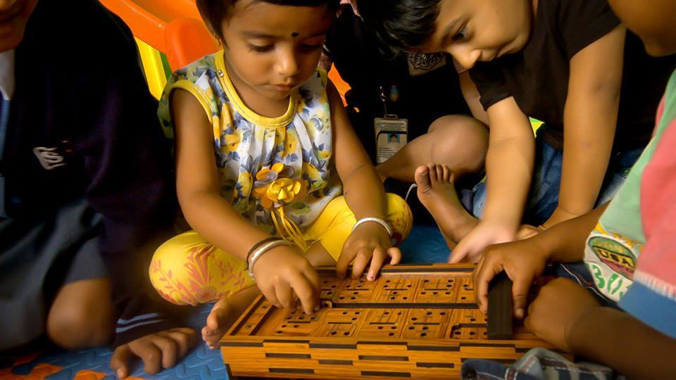
The Slate
Slate is the Brain of Robo-L. It is the place where we tell the Robot What to do. Here we put in the functions we want Robo-L to perform. Using physical coins we can tell the Robot what we want it to do by simply inserting the required coins.
It is the interface between user and Rora. You just need to tap in the coins to Program the Bot. No switches, No Screens, Just the swipe of a slider and Rora will know What to do next.

Slide 6
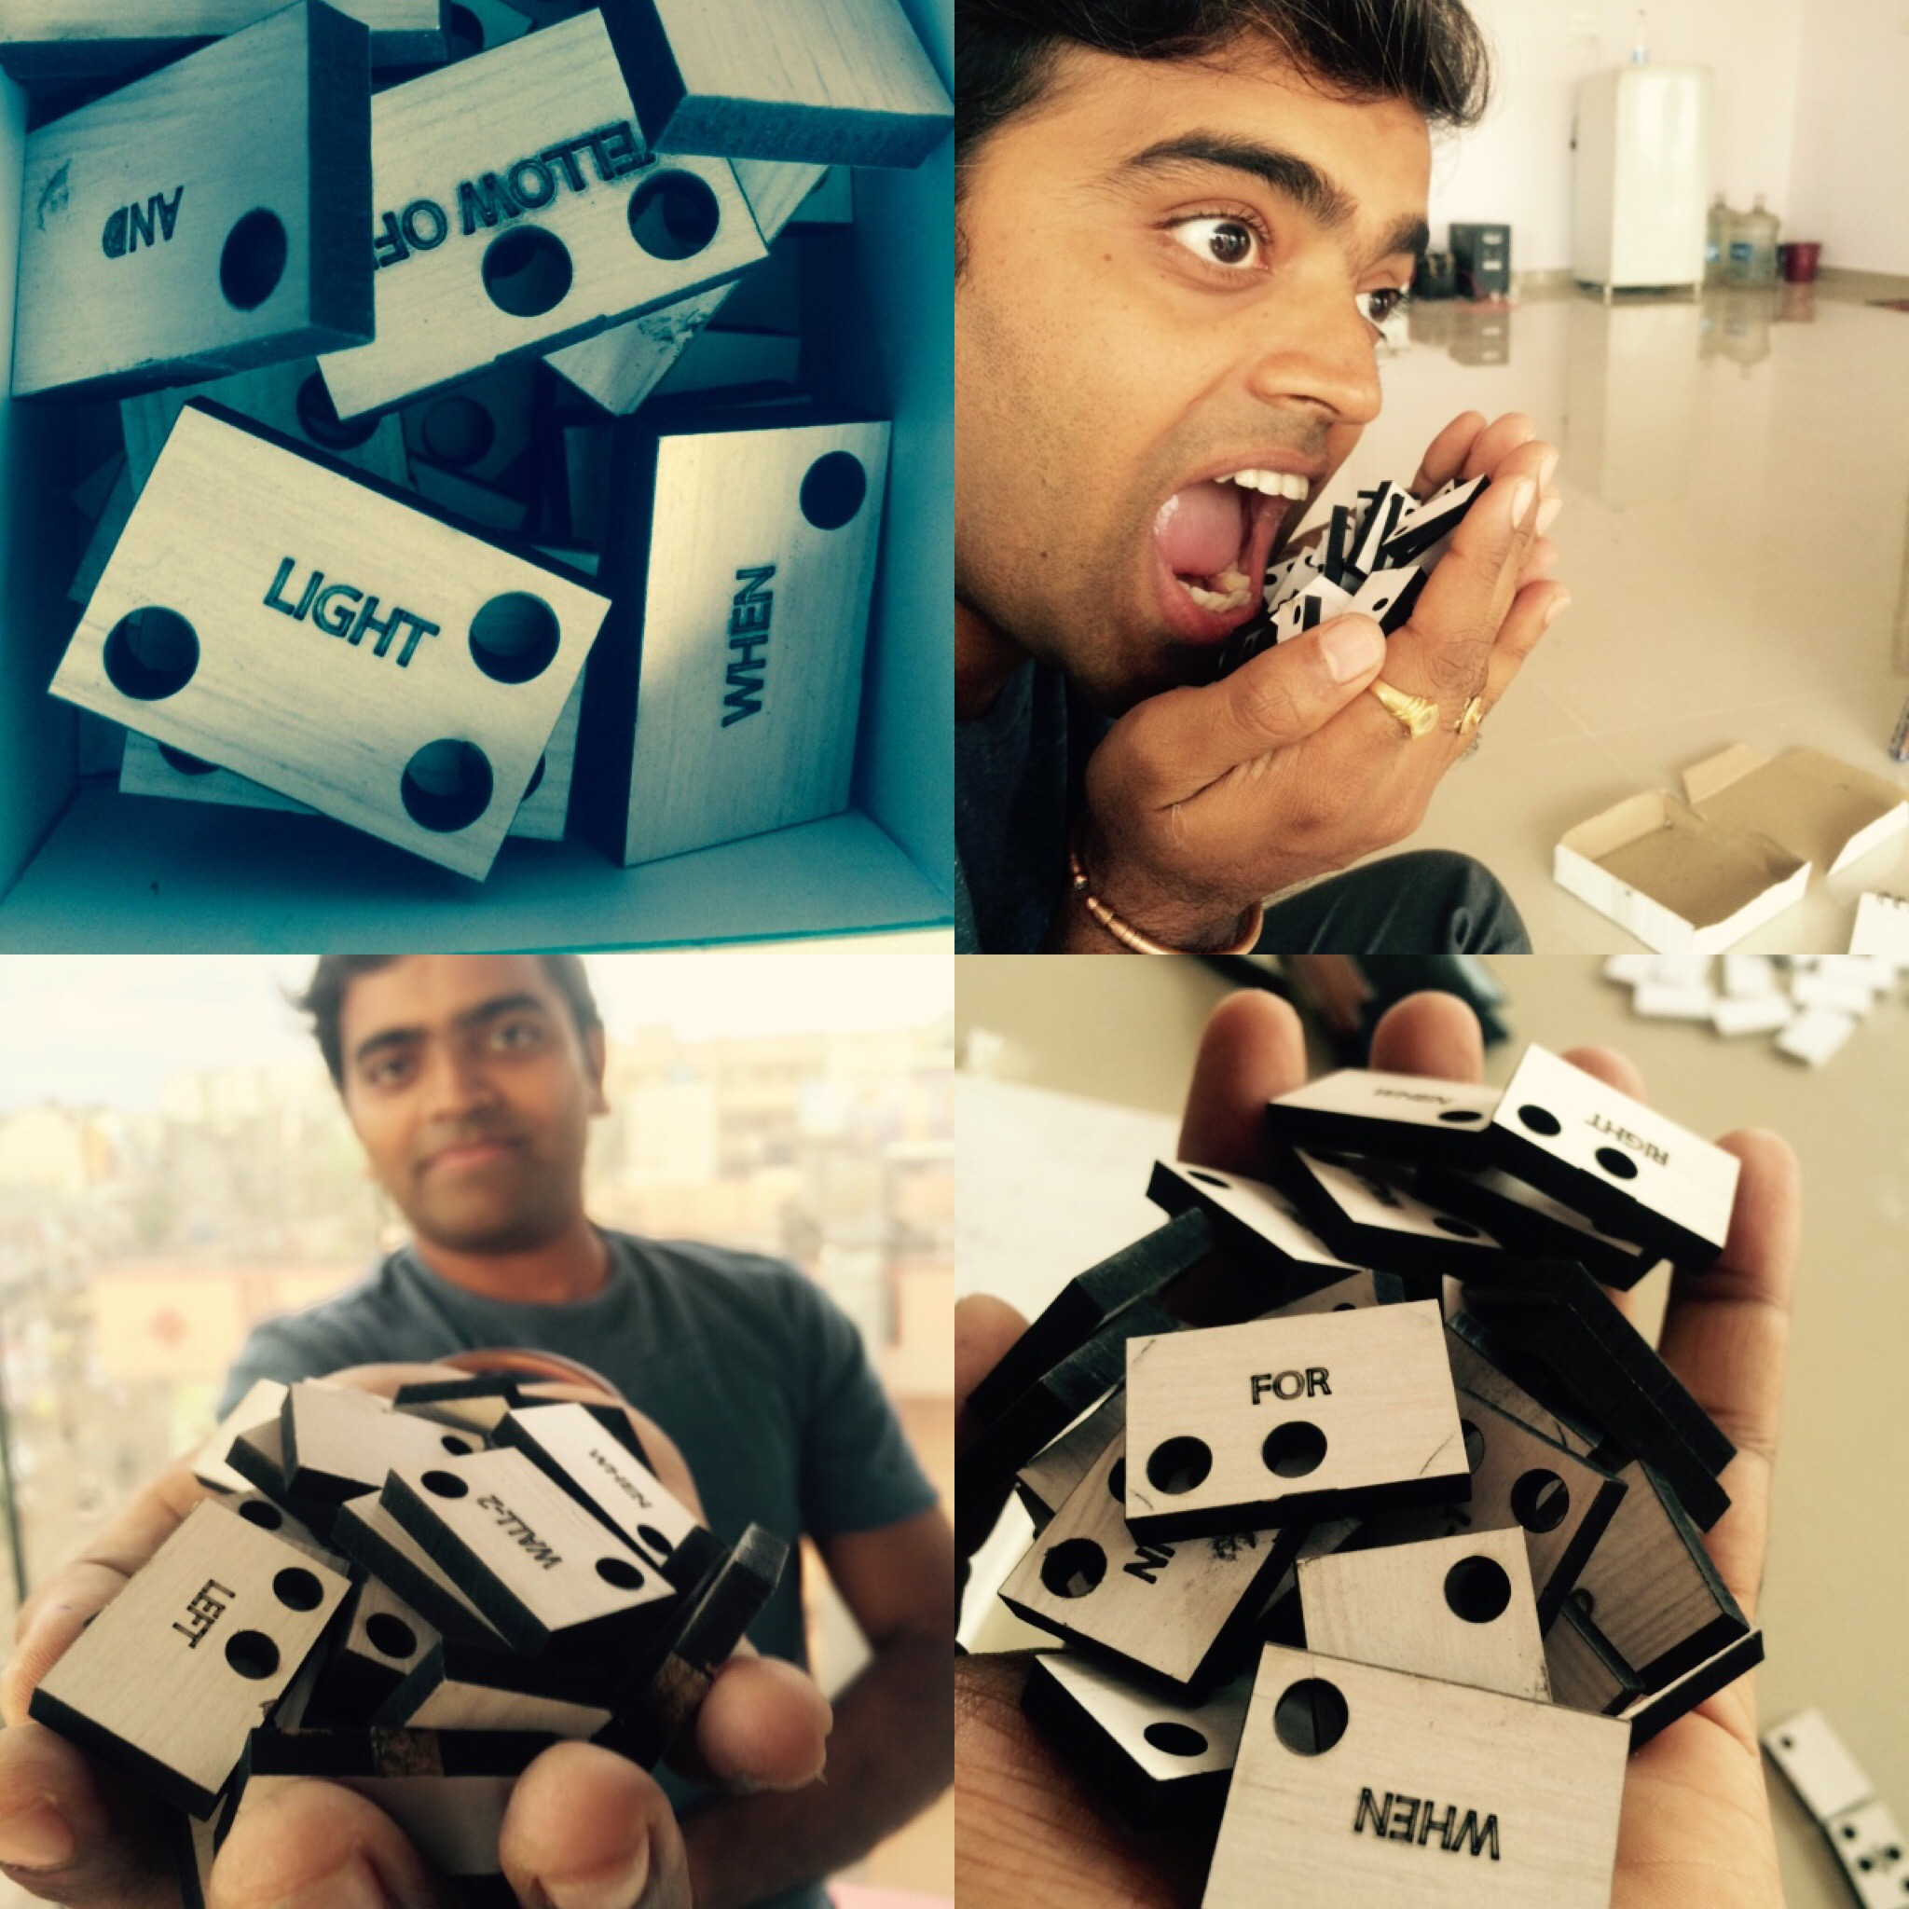
Coins
There are 48 wooden units with one specified command written on the top. These units are square shaped buttons with a specific program written on it. Like LEFT, IF, THEN, ROTATE, BLINK, FORWARD etc. These units are used to write the Program.
Coins are individual units made up of wood. Every chip represents a command. They are written atop of each coin. These commands, when, placed in right order form an executable program. This program is then executed by the Bot in Real Time.

Slide 7
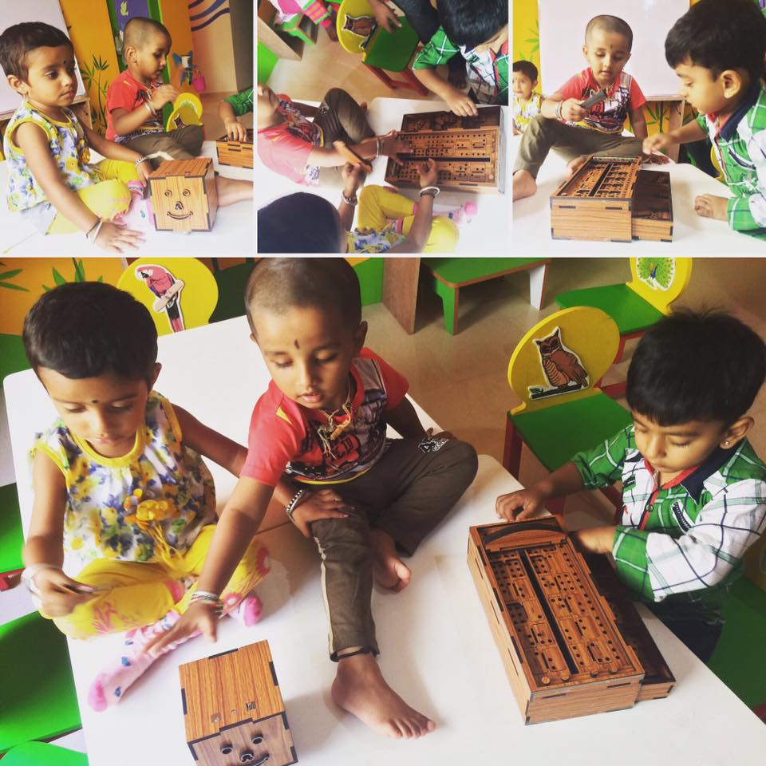
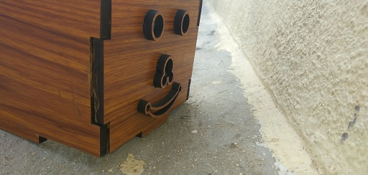
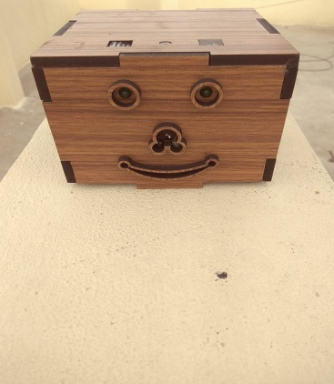
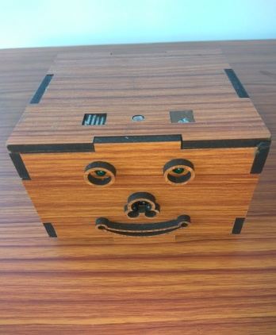
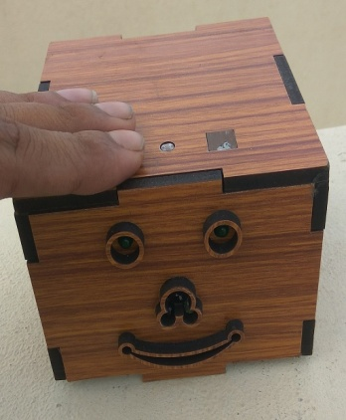
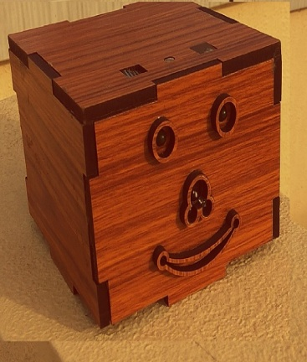
Humans have 5 senses, I got 5 too.
Robo-L is equipped with many sensors and has a delicate design. Each sensor can be used individually to perform Simple tasks as well as together for complex tasks.
Wall Sensor
Light Sensor
Rain Sensor
Touch Sensor
Sound Sensor

Slide 8
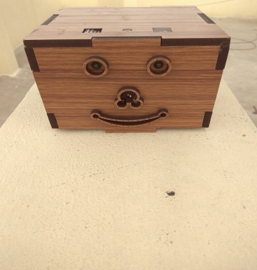


Wall Sensor- Rora will never crash unless you tell her to. She is equipped with LDRs which can sense the wall before touching it.
Rain Sensor- Rora has two Rain sensors on the top of its Body. So the next time you are running away from dripping Rain she will run with you too.
Light Sensor In older times Roosters used to give the wakeup call, Now Its Rora . Rora can detect light and for a simple program IF LIGHT BUZZ you can turn her it to perfect Morning Alarm, It will only start buzzing when the sunlight enters your Room.
Touch Sensor- Rora is designed to recognize your touch. Just start any Program with If Touch Coins and she will execute the as soon as someone touches it. Best Example If Touch Buzz and your Buddy will inform you if someone touches her without your Permission.
Sound Sensor- Rora could feel sound. You can Program her to find its way back to you whenever you clap. When you want your her to appear Just Clap.
So much for Individual Functions, you can use the Buzzer, LEDs, the movement skills, melodies etc to perform some really Cool Tasks.

Slide 9
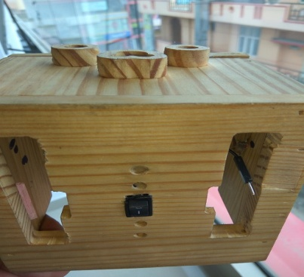
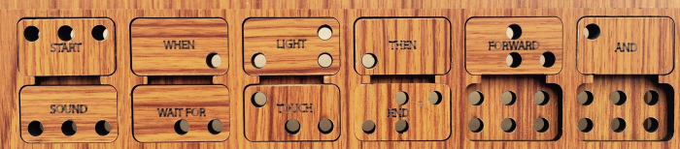
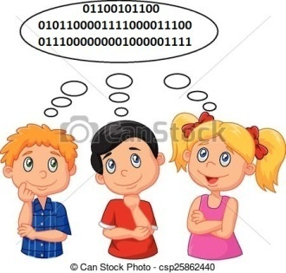
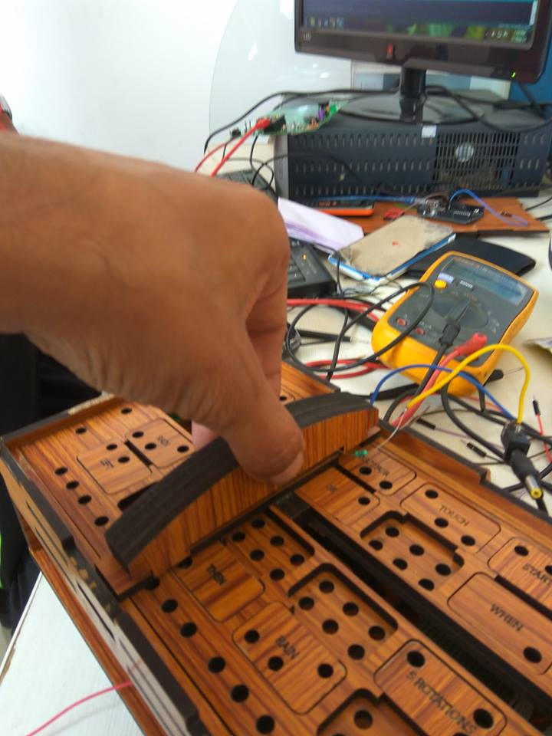
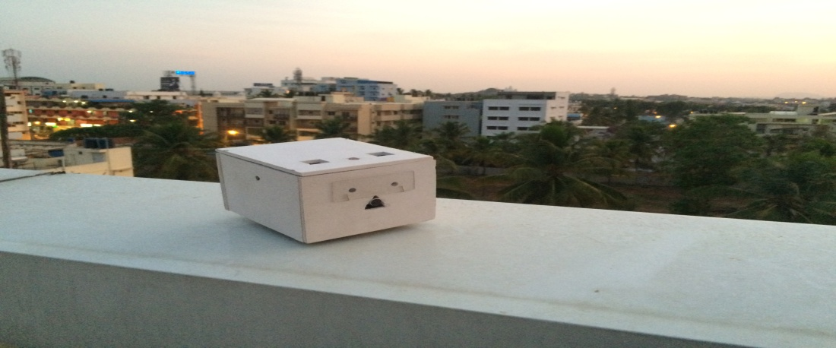
Programming with Rora
Programming Rora is as simple as counting 1, 2 , 3, 4, 5 ..
Think of an Activity.
Switch on Rora and the Slate.
Talk to Rora : Tell Rora what to do and how to do it by placing the relevant coins in the slate. (Go to the Next page to learn how to write the Programs)
Slide the Scanner to send the Program to Rora.
Rora will accomplish the work as you command.

Slide 10
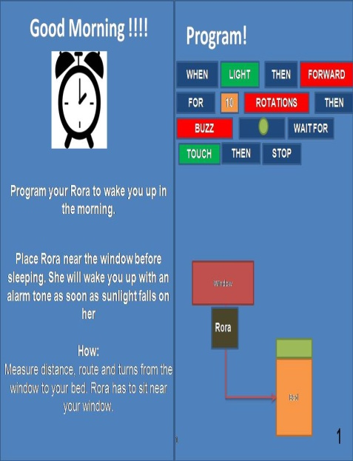
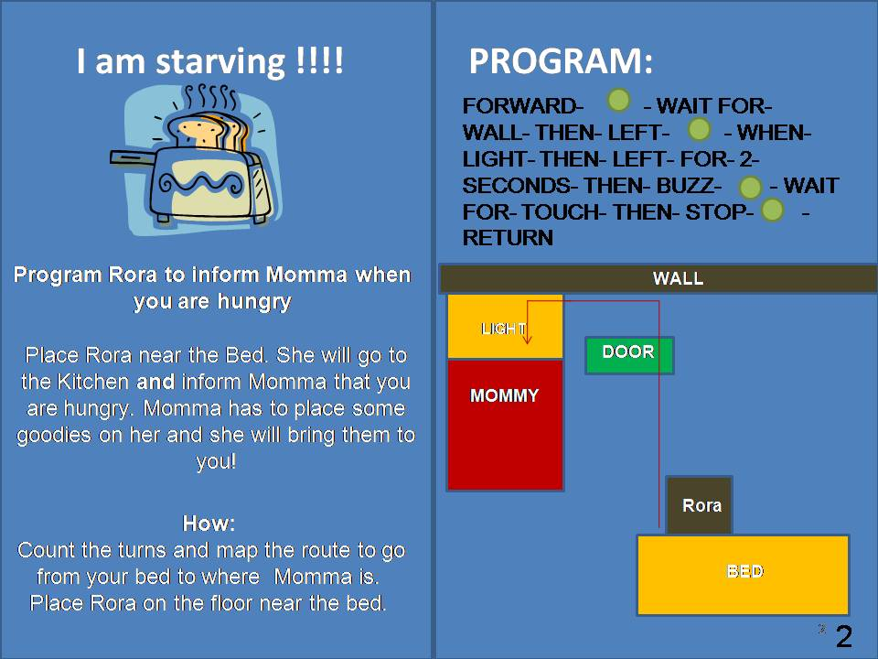
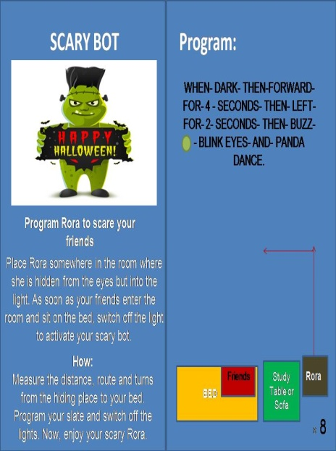
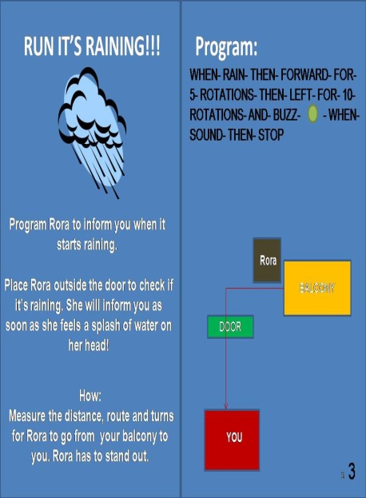
Let’s Play.
Introducing Playcards
Playcards are Games and Activities designed to help you play & understand How Rora Works.
Are you hungry? Program Rora to bring you snacks from Mommy.
Want to scare your Friends? We have some Ideas but you can always create more.
Want to measure how fast you run? We got a Program for You.
Want to wish Birthday in Style? Let Rora tune it for you.
25 Playcards are provided along with Rora in the Box.
The cards are divided in 5 stages Programmer Level 1 to Programmer Level 5.
Start with Level 1 Programs and gradually increase to Level 5 to become a pro.
On one side are brief instructions and on the other side are example Programs according to a common layout of a Room and House. In the Next pages, learn how to use them in your Room by simply changing a few coins.

Slide 11
Introducing to the Coins.
Output Coins : FORWARD- For Going Forward BLINK EYES- Both the eyes will blink
REVERSE- For Going Reverse BUZZ- Rora will start Buzzing
RIGHT- For Going Right B' DAY- Rora will sing a Birthday Melody for You
LEFT- For going Left PANDA DANCE – Rora will Dance
STOP- Always use STOP command in the last of a sentence to finish the work.
WHEN – Use this command before sound, light, touch, wall, no wall and rain to activate the senses.
THEN – Use this command to tell Rora what to do next after Rora senses the desired entity. Like – WHEN WALL THEN FORWARD.
FOR – This command is used to tell Rora the amount of time you want her to travel and the amount of distance you want her to travel. Like WHEN WALL THEN FORWARD FOR 2 SECONDS.
WHEN SOUND GO FORWARD FOR 5 FOOT
WAIT-FOR - Use this command to tell Rora to wait before starting a work. Like WHEN LIGHT WAIT-FOR 30 MINUTE THEN BUZZ.
AND – This command is used when you want Rora to perform 2 actions together. Like WHEN SOUND THEN BLINK AND BUZZ FOR 5 SECONDS. ( Always specify the length of the work or else Rora will keep doing it indefinitely)
NEXT- Next denotes the end of a sentence.
REPEAT – Use this command to repeat the work.
RETURN – Use this command to return Rora back to its initial position.

Slide 12
How to Write the Programs? ( Commanding Rora )
1. Take out the Coins from the Slate.

